Slide 1


ViroMatch: A Computational Pipeline for Detection of Viral Sequences from Complex Metagenomic Data
Todd N. Wylie / Assistant Professor of Pediatrics Pediatrics Gastroenterology Washington University School of Medicine 660 S. Euclid Avenue, Campus Box 8208 St. Louis, MO 63110
Wed Dec 30 20:59:55 CST 2020
twylie@wustl.edu

Slide 2
Disclosure
ViroCap: Compositions and methods for detecting viruses in a sample (Patent: US20170218465A1)
Enterovirus D68 real-time PCR (Patent: US20160355897A1)
VarScan: variant detection in massively parallel sequencing of individual and pooled samples (License: WUSTL Case Number 009883)
twylie@wustl.edu

Slide 3
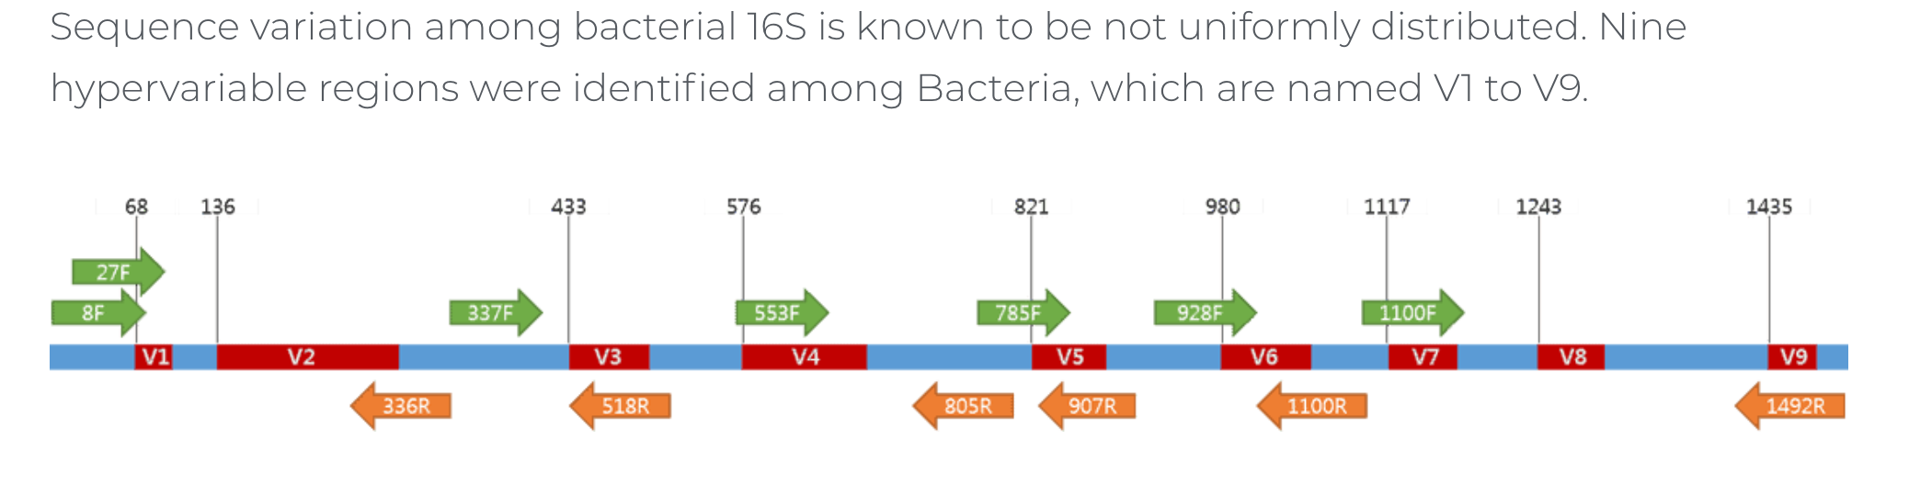
16S rRNA Sequencing
All members of Bacteria and Archaea are known to have 16S gene
We may target by amplicon sequencing the 16S gene
Subsequently, we classify bacteria based on variable sequence regions: software (UPARSE, Qime, Mothur, DADA2)
Cheap & targeted; well-established with many, many studies; community comparisons; only targets bacteria; not all bacteria can be identified down to the species/strain level; still useful
Gut microbiome studies (non-invasive – i.e. stool samples) See:
Brigida Rusconi, PhD (March 8, 2021)
“16S analysis using R-studio, DADA2, and DESeq2”
twylie@wustl.edu

Slide 4
Metagenomics
However … 16S sequencing is not metagenomics!
We want to assess all of the underlying microbiota (organisms) within a given sample – not just bacteria.
Also, we wish to characterize all of the genomes for these species (microbiome) – not a single gene, as with 16S sequencing.
Thus, we use NGS metagenomic shotgun sequencing (MSS) for metagenomic studies.
This gives us access to the virome….
twylie@wustl.edu

Slide 5
The Virome
Virome refers to the assemblage of viruses that is often investigated and described by metagenomic sequencing of viral nucleic acids that are found associated with a particular ecosystem, organism or holobiont. The word is frequently used to describe environmental viral shotgun metagenomes. Wikipedia
twylie@wustl.edu

Slide 6
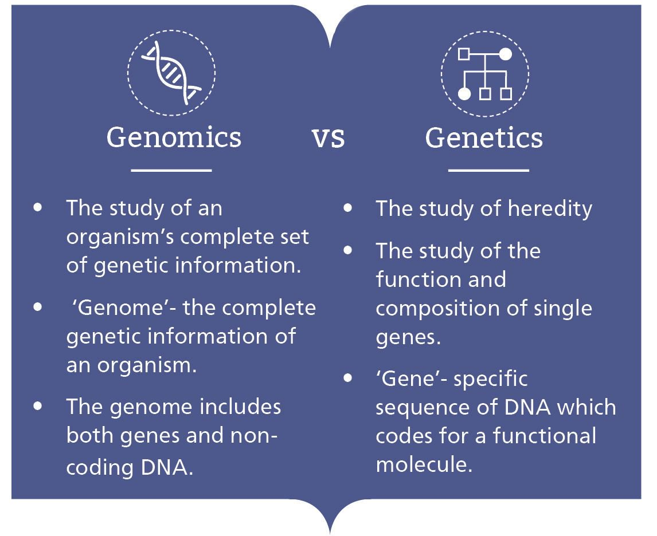
Bioinformatics Scale
URL: https://www.genomicseducation.hee.nhs.uk
twylie@wustl.edu

Slide 7

Metagenomics Bioinformatics
CHALLENGES:
Not a single reference genome, but thousands of potential references
Expanded sample types – e.g. stool, skin, CSF, NP swabs, blood, vaginal swabs, tissues (pre/post transplant), tumors, etc.
Microbiome is not static
Microbial taxonomy not always consistent
Expectation vs unknown
Not all microorganisms studied at same level
URL: https://www.nature.com/collections/scqssjswcq
twylie@wustl.edu

Slide 8
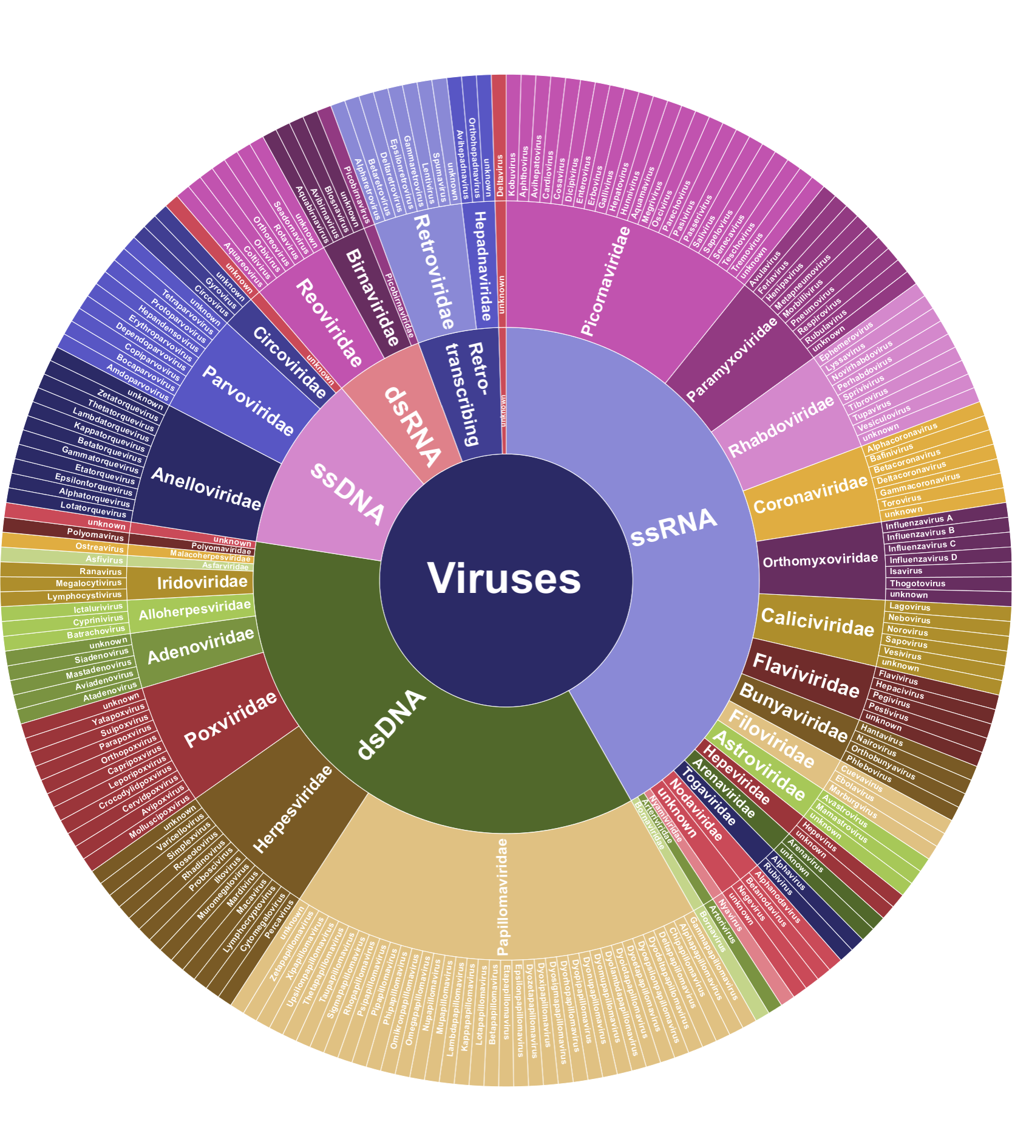
Viral Taxonomy (variation)
Note: Bacteriophage not shown.
TN Wylie, KM Wylie, et al. Genome Res. 2015 Dec; 25(12): 1910–1920.
twylie@wustl.edu

Slide 9
Viral Taxonomy (genome size)
Note: Bacteriophage not shown.
TN Wylie, KM Wylie, et al. Genome Res. 2015 Dec; 25(12): 1910–1920.
twylie@wustl.edu

Slide 10
Virus Genome Sizes
Viruses are much smaller than their counterparts!
Genome | Size (bp) | Converted to Time
Human | 3,099,706,404 | 98.2 years
E. coli | 5,498,578 | 63.6 days
SARS-CoV-2 | 29,903 | 8.3 hours
twylie@wustl.edu

Slide 11

Virome Analysis
Virome analysis challenges:
Viruses have high heterogeneity
Viral genomes are relatively smaller (e.g. host)
No gene shared among all groups of viruses (ala 16S)
Alignment parameters have to serve conflicting goals
Identify highly conserved viral genome sequences (e.g. Herpesviruses)
Identify divergent viral genome sequences (e.g. HCV)
Identify viruses without a good reference sequence available (e.g. Enterovirus subtypes)
Virus groups have different criteria for distinction (viral taxonomy is a mess)
Some genera contain viruses with high nucleotide sequence similarity
Some genera contain viruses that primarily share gene content, but not nucleotide sequence
Meaningful virus classifications are virus-specific & may require post-hoc analysis
Rotavirus and flu typed based on specific genes that can reassort (so you may type based on alignment to multiple reference genomes)
EBV-1 and -2 typed on a very specific genomic region
twylie@wustl.edu

Slide 12
Metagenomic Shotgun Sequencing (MSS)
Analysis of the viral data we’ve generated has been challenging:
Small numbers of sequences are harder to interpret/believe
Harder (or impossible) to subtype based on few sequence
We want our assays to be highly sensitive so we can accurately detect low level viruses (particularly important for control groups)
In our experience, we have detected fewer than 10 viral sequences per 25 million sequence reads generated for a virus that was detected in a sample by a molecular assay. In other instances we have failed to detect viruses known to be present based on molecular assays (Wylie, K. et al. 2012).
Why not use sequence capture?
twylie@wustl.edu

Slide 13
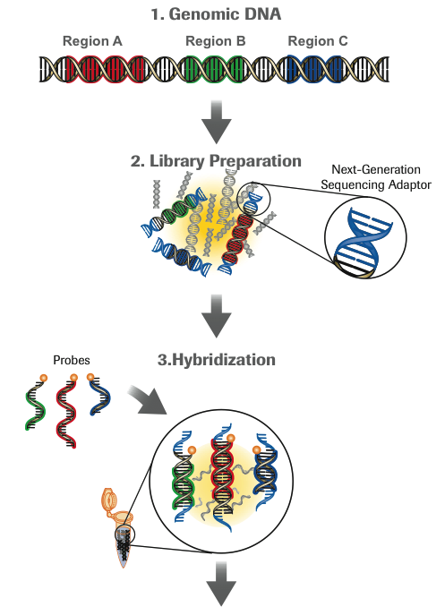
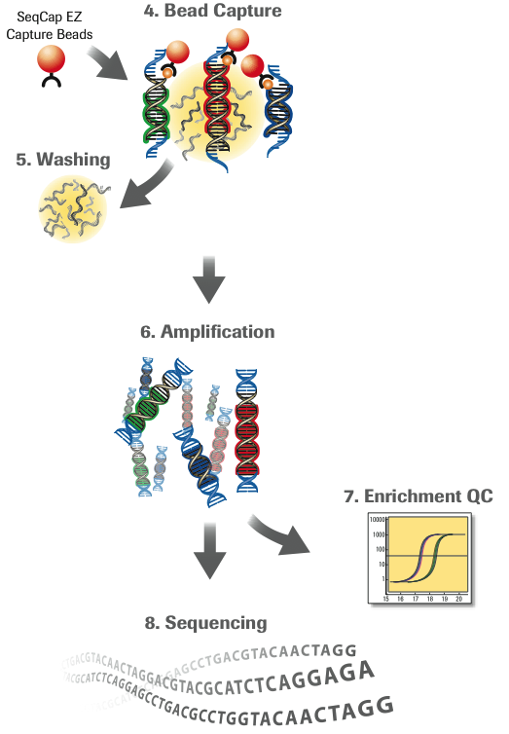
Roche NimbleGen SeqCap EZ Library

Slide 14
Viral Capture Goals
Our aim was to develop a virus-specific sequence capture reagent that could be used to
assess all known viruses that can infect human cells, making a priori knowledge of the viruses within a sample unnecessary and
detect novel or divergent human viruses.
To this end, we targeted sequence capture platforms capable of enhancing the detection of a comprehensive set of viruses with vertebrate and invertebrate (insect) hosts.
twylie@wustl.edu

Slide 15
ViroCap
ViroCap includes targets from 34 viral families, which consist of 190 genera and 337 species.
The viruses included represent all viruses with sequenced genomes from vertebrate and invertebrate hosts.
Nearly 1 billion bases of viral genome sequence was condensed into less than 200 million bases of target sequence using k-mer and clustering analyses to select a unique set of reference sequences.
twylie@wustl.edu

Slide 16
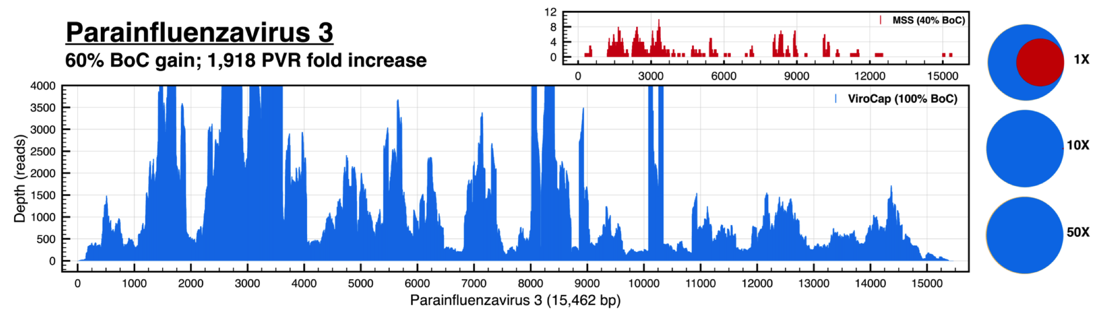
100% coverage with ViroCap
twylie@wustl.edu

Slide 17
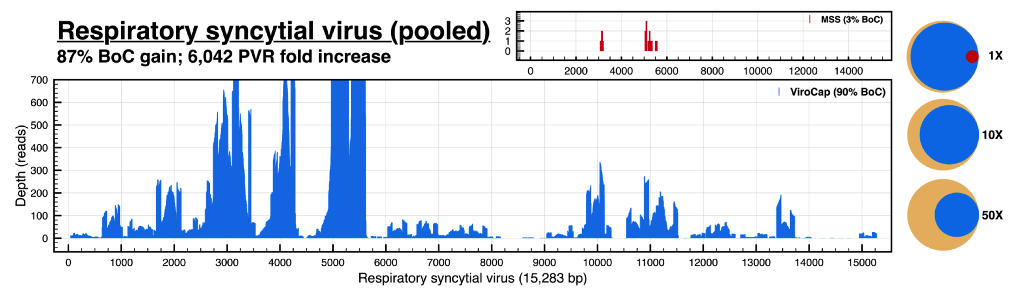
MSS: low detection
twylie@wustl.edu

Slide 18
Viral Capture Summary
We’ve designed and tested a large scale viral capture assay, ViroCap.
ViroCap provides viral sequence enrichment hundreds to thousands of fold increase over MSS.
Divergent viruses were captured with as low as 70% sequence similarity in our initial tests.
Bioinformatics approaches to capture sequence selection reduced potential sequence target pools 3-29X.
Limitations include library representation, very low input samples, and cost.
We often use ViroCap enrichment in our metagenomic studies.
twylie@wustl.edu

Slide 19
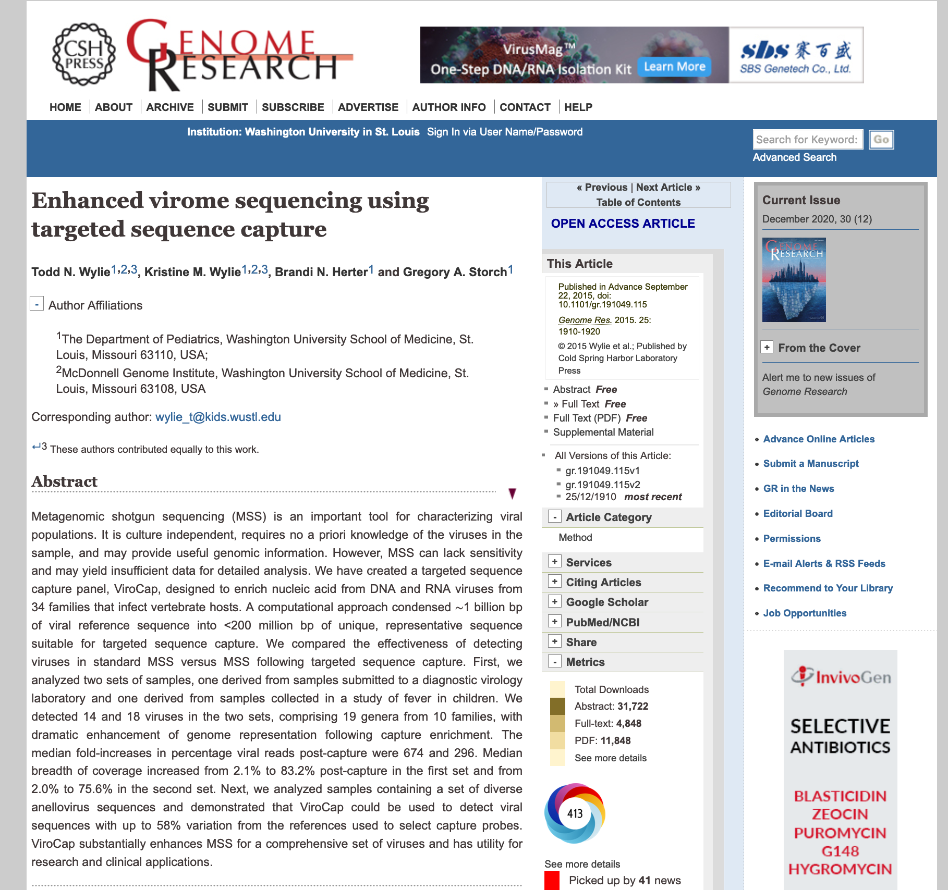
ViroCap
twylie@wustl.edu

Slide 20
ViroMatch
In our metagenomic studies, ViroCap followed by ViroMatch is our one-two punch!
ViroMatch is a virus characterization pipeline that evaluates NGS nucleotide reads. It screens/removes host sequences and performs nucleotide and translated nucleotide alignments in an iterative fashion. Candidate virus reads are validated against all current references in NCBI nt/nr.
twylie@wustl.edu

Slide 21
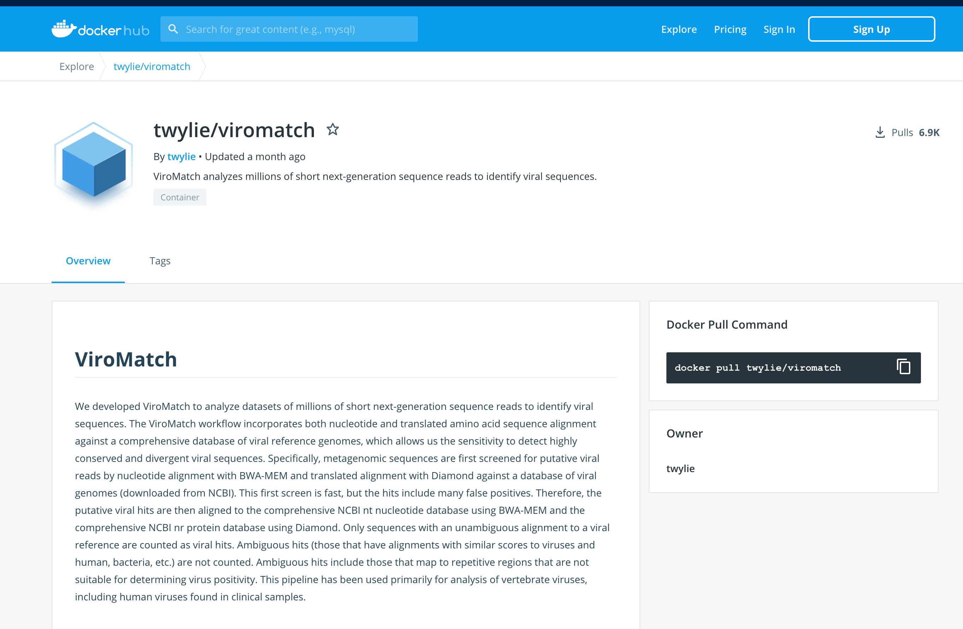
https://hub.docker.com/r/twylie/viromatch
twylie@wustl.edu

Slide 22
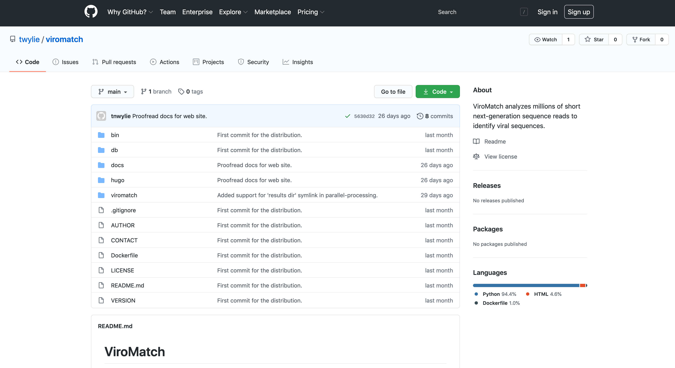
https://github.com/twylie/viromatch
twylie@wustl.edu

Slide 23
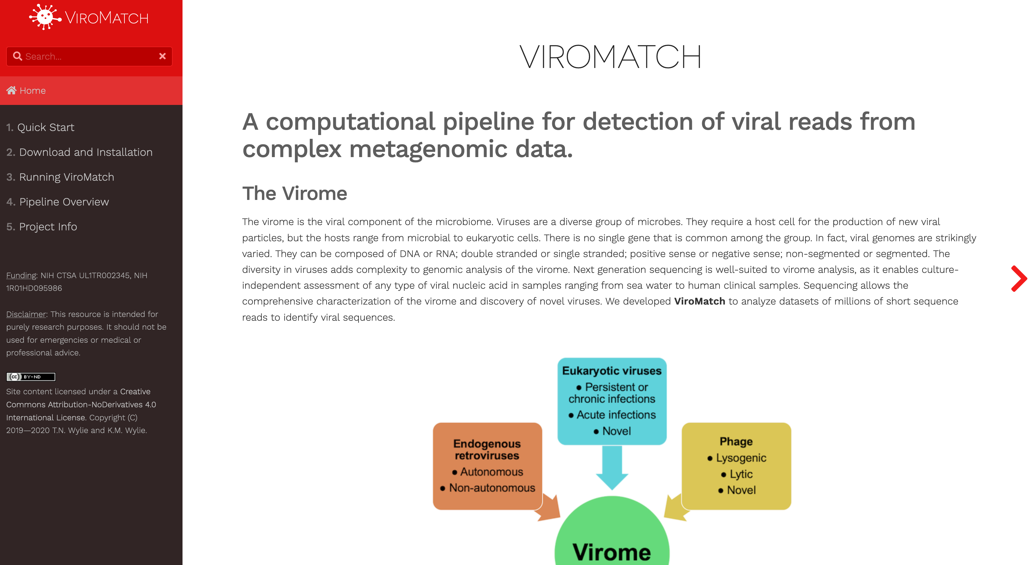
https://twylie.github.io/viromatch/
twylie@wustl.edu

Slide 24
Alternative software
Several NGS virus detection software packages have been published since the HGP. Many focus on k-mer based analysis or lack translated alignments.
Kraken2 --- Wood DE, Salzberg SL: Kraken: ultrafast metagenomic sequence classification using exact alignments. Genome Biology 2014, 15:R46.
MetaPhlAn2 --- Metagenomic microbial community profiling using unique clade-specific marker genes. Nicola Segata, Levi Waldron, Annalisa Ballarini, Vagheesh Narasimhan, Olivier Jousson, Curtis Huttenhower. Nature Methods, 8, 811–814, 2012
Taxonomer --- Flygare S, Simmon K, Miller C, Qiao Y, Kennedy B, Di Sera T, Graf EH, Tardif KD, Kapusta A, Rynearson S, Stockmann C, Queen K, Tong S, Voelkerding KV, Blaschke A, Byington CL, Jain S, Pavia A, Ampofo K, Eilbeck K, Marth G, Yandell M, Schlaberg R. Taxonomer: an interactive metagenomics analysis portal for universal pathogen detection and host mRNA expression profiling. Genome Biol. 2016 May 26;17(1):111. doi: 10.1186/s13059-016-0969-1. PubMed PMID: 27224977
Virome Seeker --- Zhao G, Wu G, Lim ES, Droit L, Krishnamurthy S, Barouch DH, Virgin HW, Wang D. VirusSeeker, a computational pipeline for virus discovery and virome composition analysis. Virology. 2017 Mar;503:21-30. doi: 10.1016/j.virol.2017.01.005. Epub 2017 Jan 18. PubMed PMID: 28110145
VirFinder --- Ren J, Ahlgren NA, Lu YY, Fuhrman JA, Sun F. VirFinder: a novel k-mer based tool for identifying viral sequences from assembled metagenomic data. Microbiome. 2017 Jul 6;5(1):69. doi: 10.1186/s40168-017-0283-5. PubMed PMID: 28683828
SURPI --- Naccache SN, Federman S, Veeraraghavan N, Zaharia M, Lee D, Samayoa E, Bouquet J, Greninger AL, Luk KC, Enge B, Wadford DA, Messenger SL, Genrich GL, Pellegrino K, Grard G, Leroy E, Schneider BS, Fair JN, Martínez MA, Isa P, Crump JA, DeRisi JL, Sittler T, Hackett J Jr, Miller S, Chiu CY. A cloud-compatible bioinformatics pipeline for ultrarapid pathogen identification from next-generation sequencing of clinical samples. Genome Res. 2014 Jul;24(7):1180-92. doi: 10.1101/gr.171934.113. Epub 2014 Jun 4. PubMed PMID: 24899342
twylie@wustl.edu

Slide 25
Computational burden and costs
Disk space:
active/spinning
cold storage (access-only)
high-speed (database access)
archival (tape backup)
Memory (RAM)
Parallel computing support (e.g. Platform LSF)
Platform (OS) support
Installed dependencies and software requirements
Versioned software
Ancillary database support
Computation: CPU speed, number of cores
Network: sftp, ssh, or VPN remote access
Security and privacy
twylie@wustl.edu
Notes:
As long as project is active, we need disk space
Cumulative cohort data for aggregate analysis
Re-analysis
Data scrubbing and preparatory work (de-noising or data cuts)
Need to account for these things in grants

Slide 26

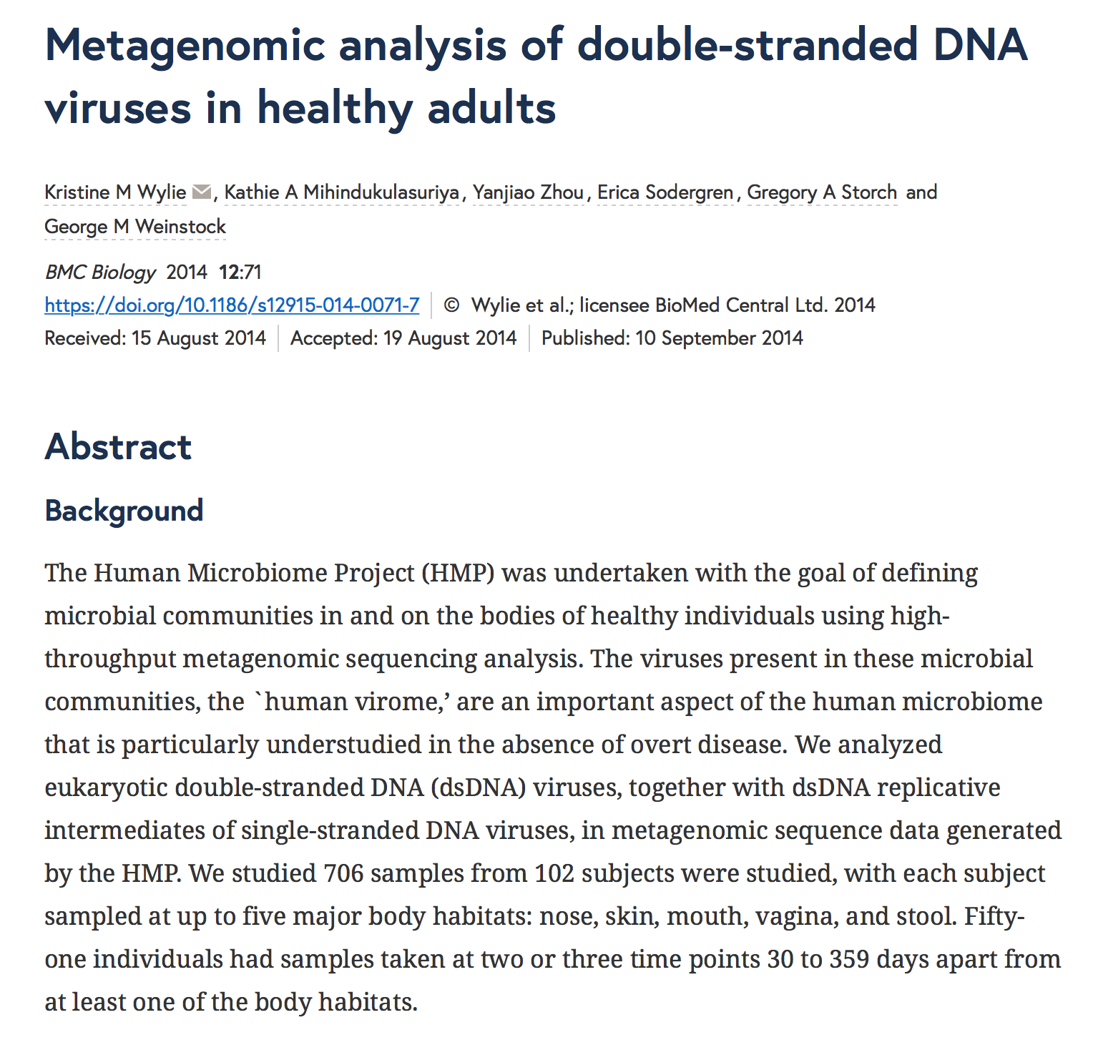
HMP: Virome Pipeline
Kristine Wylie, PhD
Department of Pediatrics • McDonnell Genome Institute
Wylie KM, Mihindukulasuriya KA, Zhou Y, Sodergren E, Storch GA, Weinstock GM. Metagenomic analysis of double-stranded DNA viruses in healthy adults. BMC Biol. BioMed Central Ltd; 2014;12(1):71.
Wylie KM, Mihindukulasuriya KA, Sodergren E, Weinstock GM, Storch GA. Sequence analysis of the human virome in febrile and afebrile children. PLoS One. 2012;7(6):e27735. doi: 10.1371/journal.pone.0027735. Epub 2012 Jun
Wylie TN, Wylie KM, Herter BN, Storch GA. Enhanced virome sequencing using targeted sequence capture. Genome Res. 2015 Dec;25(12):1910-20. doi: 10.1101/gr.191049.115. Epub 2015 Sep 22.
Holtz LR, Wylie KM, Sodergren E, Jiang Y, Franz CJ, Weinstock GM, Storch GA, Wang D. Astrovirus MLB2 viremia in febrile child. Emerg Infect Dis. 2011 Nov;17(11):2050-2.
McElvania TeKippe E, Wylie KM, Deych E, Sodergren E, Weinstock G, Storch GA. Increased prevalence of anellovirus in pediatric patients with fever. PLoS One. 2012;7(11):e50937. doi: 10.1371/journal.pone.0050937. Epub 2012 Nov 30. PubMed PMID: 23226428; PubMed Central PMCID: PMC3511395.
ca. 2010-2012
ViroMatch goals:
research not clinical • one-step automation • replacement of proprietary components • efficient usage of resources • map reduce for database splitting/handling • CLI options (not hardcoded) • taxonomy API • OOP code base for extensibility • Docker deployment (HPC)
twylie@wustl.edu

Slide 27
ViroMatch Funding
National Institute of Health Clinical and Translational Science
NIH CTSA UL1TR002345 Institute of Clinical and Translational Sciences Award (ICTS) ICTS GRANT ID#: CTRFP2019-17 (CSTA1215) "Tools for Automated Interpretation of Viruses from Next-Generation Sequencing Data” ICTS/Washington University School of Medicine PI: Todd N. Wylie
National Institute of Health Research Project (R01)
1R01HD095986 "The Vaginal Microbiome, Maternal Response, and Preterm Birth” Washington University School of Medicine PIs: Kristine M. Wylie; Molly Stout
twylie@wustl.edu

Slide 28
ViroMatch Overview
twylie@wustl.edu
Notes:
As long as project is active, we need disk space
Cumulative cohort data for aggregate analysis
Re-analysis
Data scrubbing and preparatory work (de-noising or data cuts)
Need to account for these things in grants

Slide 29
Micro-transactions
Adaptor Trimming
Quality Trimming
Repeat Masking
>@D00170:57:CA2R8ANXX:4:1113:3715:56038AATATTCCTGATACGTGAATGATGATTTGGTGGCCCCTGCTGGACTTGAACCAGCGACCAAGCGATTATGAGTCGCCTGCTCTAACCACTGAGCTAAAGG
Viral Identity
NCBI nt/nt Identity
Host Screening
Best Hit Logic
Taxonomy Lookup
Six-Frame Translation
0.0005 sec/transaction
9 transactions = 0.0045
50,000,000 transactions = 225,000 seconds
225,000 seconds = 62.5 hours
twylie@wustl.edu

Slide 30
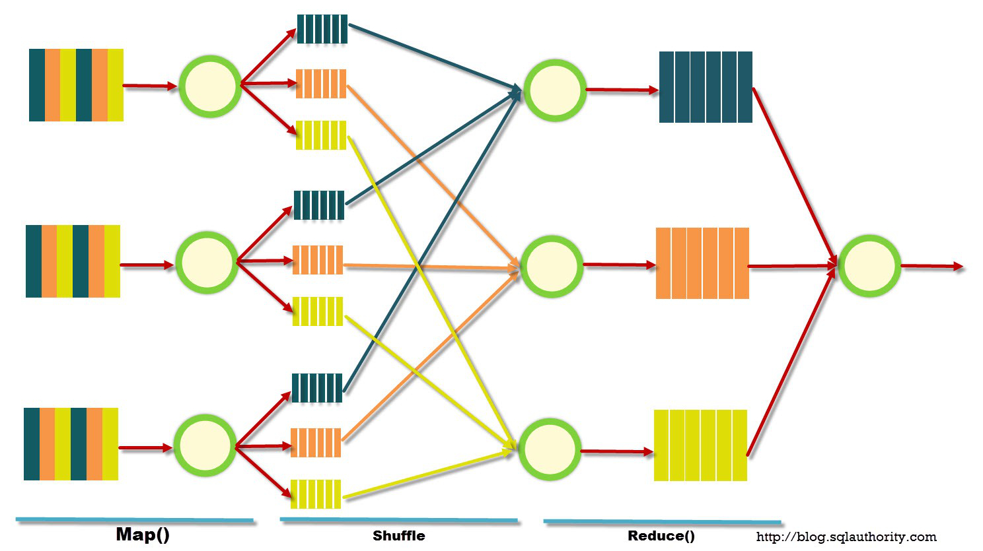
Map Reduce (NCBI nt/nr databases)
twylie@wustl.edu

Slide 31
ViroMatch DBs
Database | Description
Adaptor | Sequences used for trimming adaptor.
Host | Human reference genome.
Viral DB (nucleotide) | Database of viral sequences from GenBank & RefSeq. (1 file)
Viral DB (translated nucleotide) | Six-frame translated version of Viral DB. (1 file)
NCBI nt – 75 files, <4 GB each | Split version of NCBI nt.
NCBI nr – 41 files, <4 GB each | Split version of NCBI nr.
twylie@wustl.edu
Notes:
As long as project is active, we need disk space
Cumulative cohort data for aggregate analysis
Re-analysis
Data scrubbing and preparatory work (de-noising or data cuts)
Need to account for these things in grants

Slide 32
System Resources
In terms of disk space and memory, requirements vary depending on the size of the samples you are processing.
We have run ViroMatch on thousands of samples, ranging from 1 million reads to over 200 million reads processed. At lower boundary single core processing, we have processed 30 million reads using 8 GB of memory and 105 GB of disk space and 17:04 runtime. The same data set was parallel processed using 100 cores and 8 GB memory in under 5 hours, same disk space.
As a general rule of thumb, we use 16 GB of memory.
Disk space needed for ViroMatch processing can be considerable (potentially hundreds of gigabytes) depending on the number of reads processed per sample, especially if the --keep option is used to retain all temporary files.
twylie@wustl.edu

Slide 33
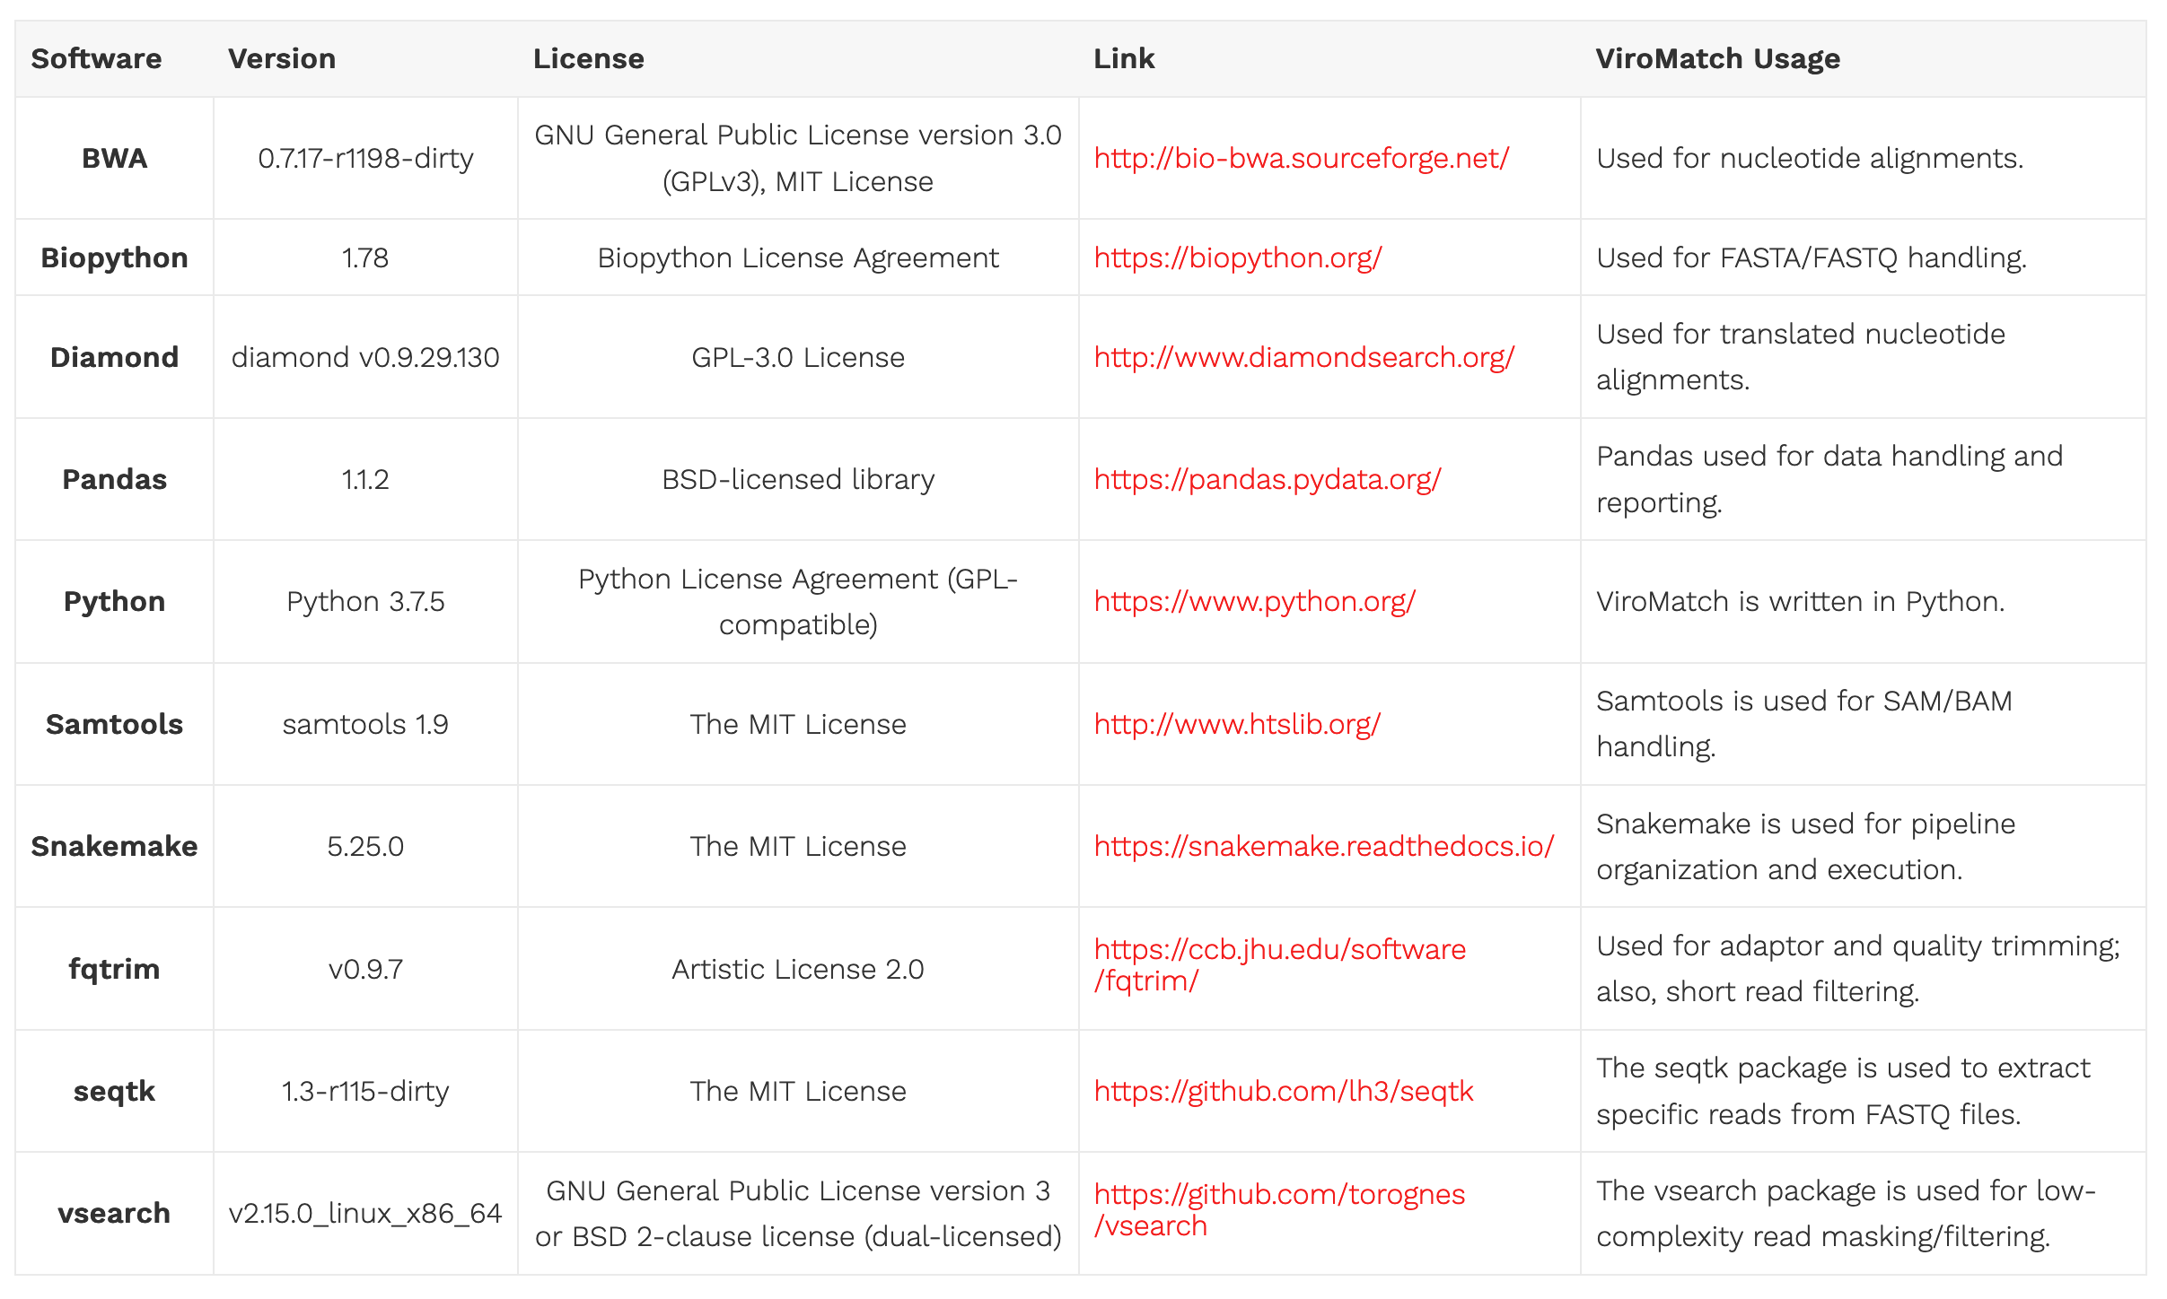
ViroMatch Dependencies
twylie@wustl.edu
Notes:
As long as project is active, we need disk space
Cumulative cohort data for aggregate analysis
Re-analysis
Data scrubbing and preparatory work (de-noising or data cuts)
Need to account for these things in grants

Slide 34
Runtime
We processed 11,829,946 reads using a single core and 16 GB of RAM in a total of 8:00:06 runtime.
This same sample was parallel-processed on the WashU compute1 LSF server using 150 cores (16 GB RAM each) and finished in 2:35:45 runtime.
Steps like validate_nuc_nt_mapping and validate_trans_nuc_nr_mapping benefit greatly from parallel-processing, as their processes are computationally intensive across multiple discrete iterations within the step.
https://twylie.github.io/viromatch/download_and_install/prerequisites/#example-runtime-breakdown
twylie@wustl.edu

Slide 35
ViroMatch Usage
LSF_DOCKER_VOLUMES="/storage1/fs1/kwylie/Archive/2020_09_21_AHA_RAW_DATA_ONLY/RAW_DATA:/storage1/fs1/kwylie/Archive/2020_09_21_AHA_RAW_DATA_ONLY/RAW_DATA /storage1/fs1/kwylie/Active/viromatchDBs:/storage1/fs1
/kwylie/Active/viromatchDBs /storage1/fs1/kwylie/Active/2020_09_21_AHA:/storage1/fs1/kwylie/Active/2020_09_21_AHA/ /scratch1/fs1/kwylie/testPP:/scratch1/fs1/kwylie/testPP" \
bsub \
-M 16G -R "select[mem>16G] rusage[mem=16G]" \
-G compute-kwylie \
-q general \
-e $PWD/LSF.err \
-o $PWD/LSF.out \
-a 'docker(twylie/viromatch:latest)' \
viromatch \
--input /storage1/fs1/kwylie/Archive/2020_09_21_AHA_RAW_DATA_ONLY/RAW_DATA/gerald_HG3LNDSXY_4_GGTTGGAC-TACAGGAT.bam \
--outdir /scratch1/fs1/kwylie/testPP/test \
--host /storage1/fs1/kwylie/Active/viromatchDBs/host/GRCh38_latest_genomic.fna \
--adaptor /storage1/fs1/kwylie/Active/viromatchDBs/adaptor/adaptor.fqtrim \
--nt /storage1/fs1/kwylie/Active/viromatchDBs/ncbi/nt/nt.pp.fofn \
--nr /storage1/fs1/kwylie/Active/viromatchDBs/ncbi/nr/nr.pp.fofn \
--sampleid 'GAGATTCC-CCTATCCT_S58_L001' \
--viralfna /storage1/fs1/kwylie/Active/viromatchDBs/viral-only/nuc/ncbi_viral_refseq_gn_20191120.fna \
--viralfaa /storage1/fs1/kwylie/Active/viromatchDBs/viral-only/trans_nuc/ncbi_viral_refseq_gn_20191120.dmnd \
--taxid /storage1/fs1/kwylie/Active/viromatchDBs/taxonomy/taxonomy.tsv \
--keep \
--wustlconfig $PWD/run.yaml
twylie@wustl.edu
Notes:
As long as project is active, we need disk space
Cumulative cohort data for aggregate analysis
Re-analysis
Data scrubbing and preparatory work (de-noising or data cuts)
Need to account for these things in grants

Slide 36
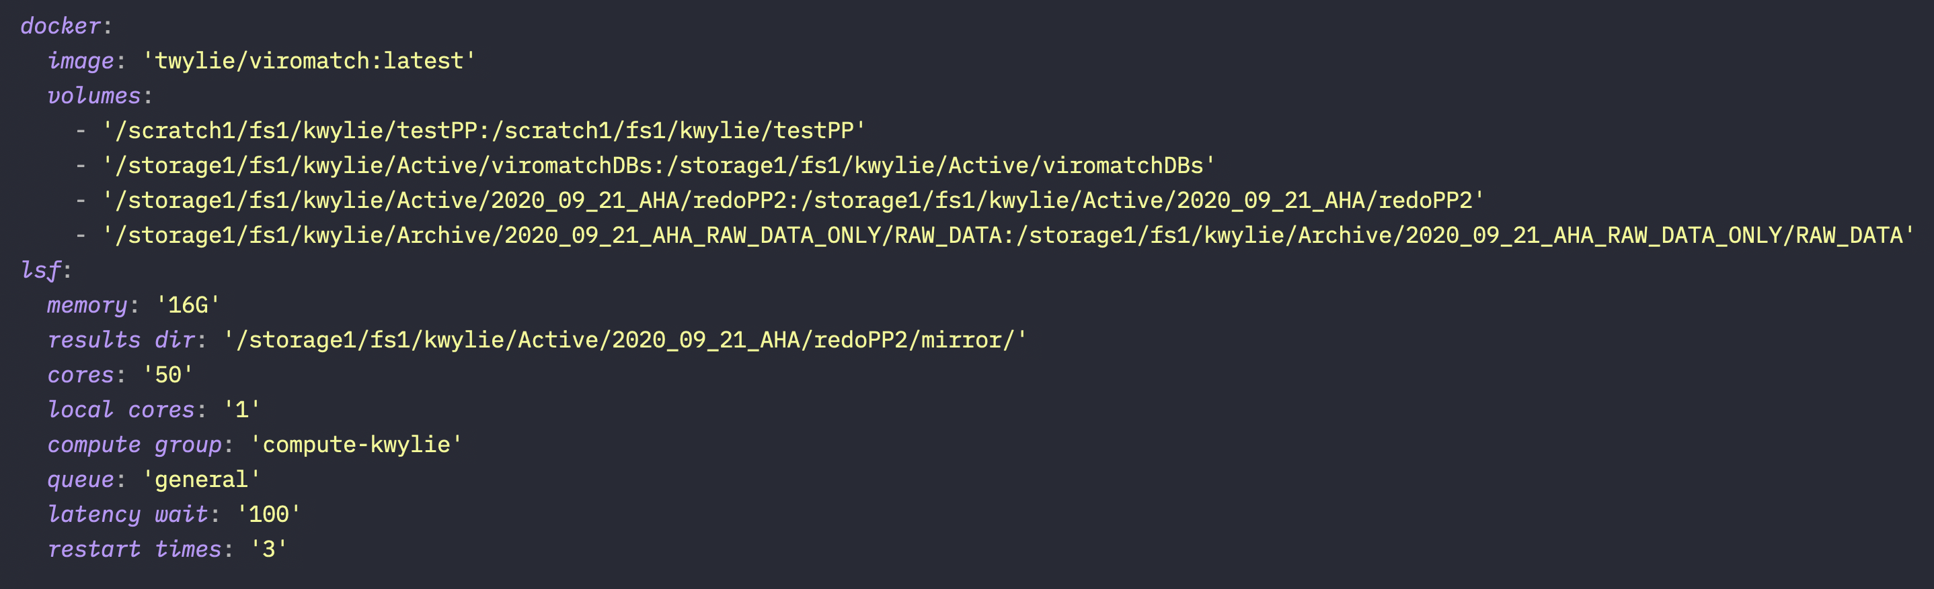
--wustlconfig (parallel processing)
twylie@wustl.edu
Notes:
As long as project is active, we need disk space
Cumulative cohort data for aggregate analysis
Re-analysis
Data scrubbing and preparatory work (de-noising or data cuts)
Need to account for these things in grants

Slide 37
Snakemake
Snakemake is a workflow management system (WMS)
Other WGS: Galaxy, CWL, GNU Make, NextFLow, Taverna, Arvados, DNAnexus, SevenBridges, etc.
Snakemake was written by an bioinformatician (Johannes Köster) and has been around since 2011—2012; approx. 230,000+ downloads and 5 new citations a week
Cross-platform (*nix, Mac, Windows) and portable
Free and open source (MIT license)
Snakemake uses pure Python syntax. There is no tool specific-language to learn like in GNU Make, NextFlow, WDL, etc.
Anything that you can do in Python, you can do with Snakemake (since you can pretty much execute arbitrary Python code anywhere
Highlights:
Reproducibility
Readability
Parallel processing and multi-core support
Scalable to server, cluster, and grid/cloud computing
Friendly for Python and R users
Use of “fuzzy” wildcards
twylie@wustl.edu

Slide 38
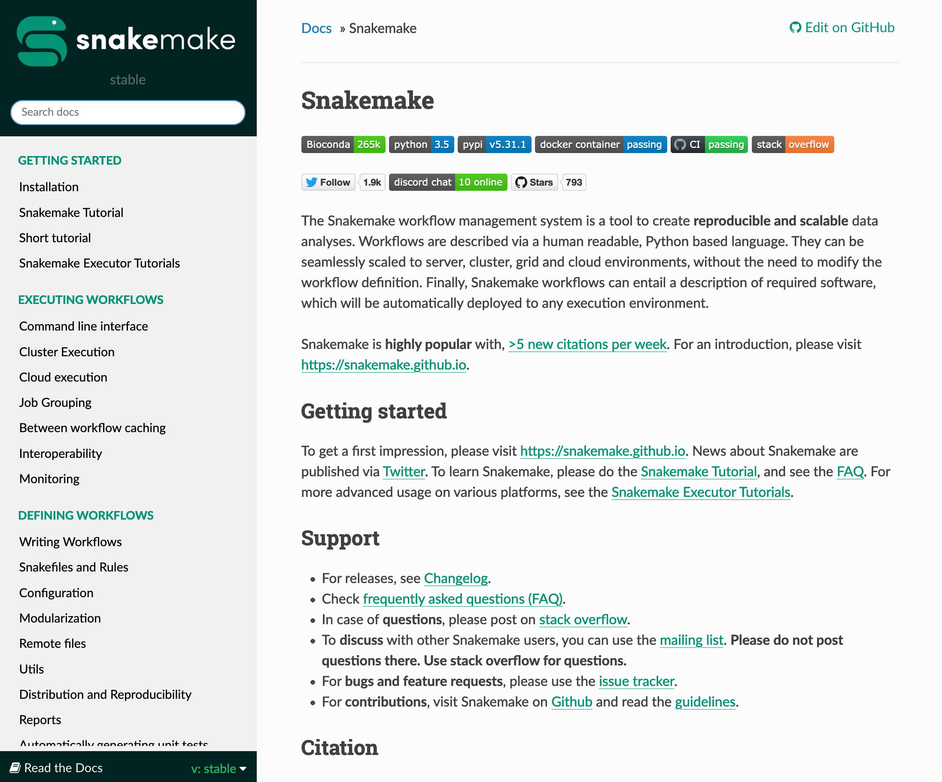
https://snakemake.readthedocs.io
twylie@wustl.edu

Slide 39
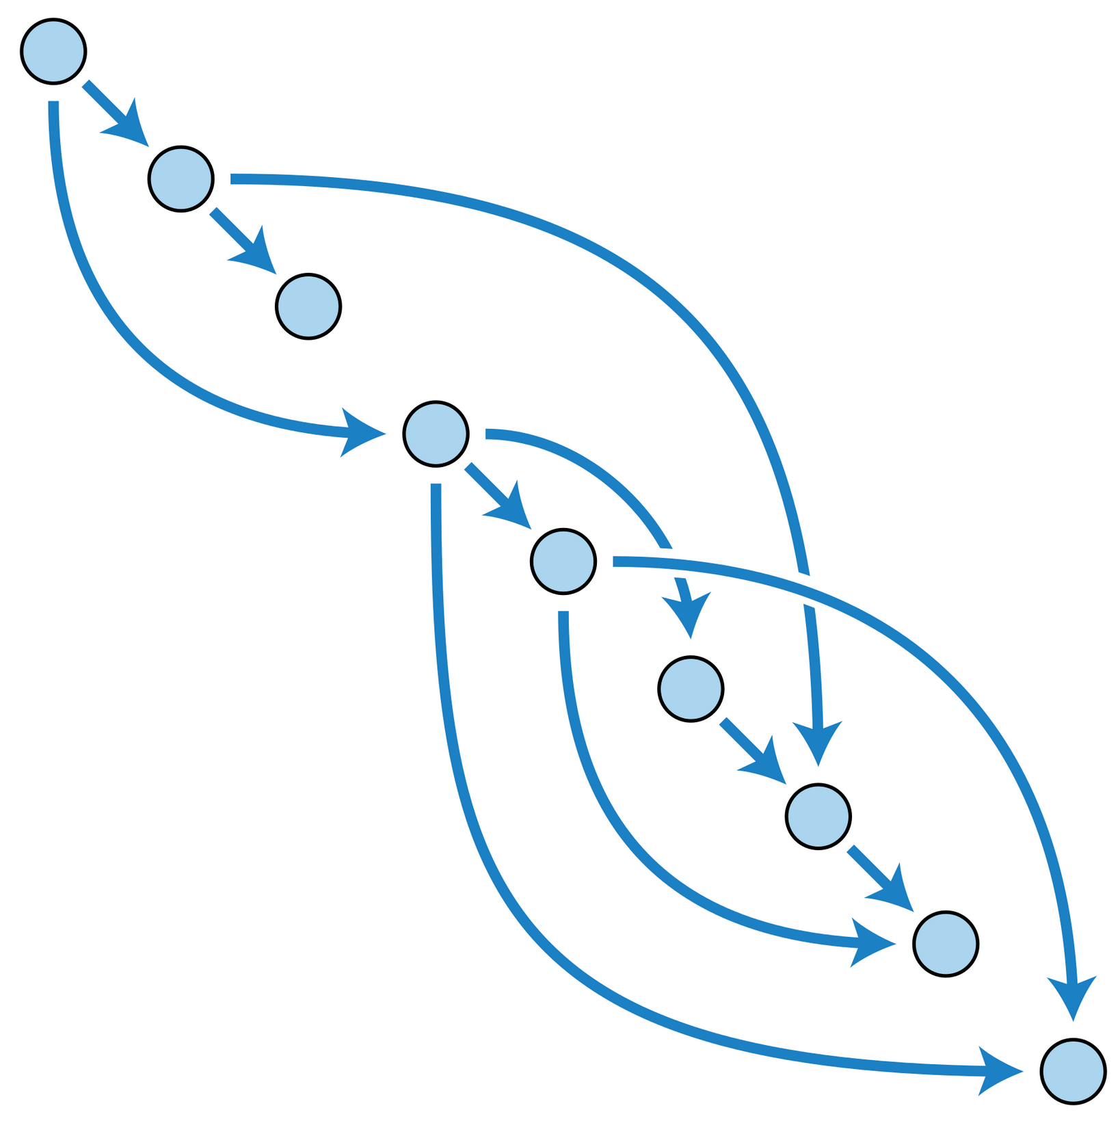
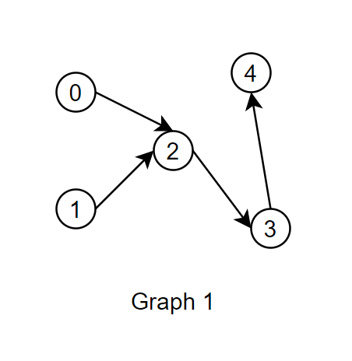
Directed acyclic graph (DAG)
“In mathematics, particularly graph theory, and computer science, a directed acyclic graph (DAG) is a directed graph with no directed cycles. That is, it consists of vertices and edges (also called arcs), with each edge directed from one vertex to another, such that following those directions will never form a closed loop. A directed graph is a DAG if and only if it can be topologically ordered, by arranging the vertices as a linear ordering that is consistent with all edge directions. DAGs have numerous scientific and computational applications, ranging from biology (evolution, family trees, epidemiology) to sociology (citation networks) to computation (scheduling).” -- Wikipedia
twylie@wustl.edu

Slide 40
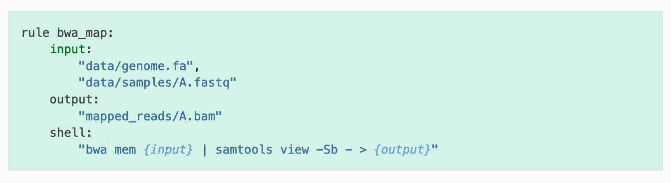
Directed acyclic graph (DAG)
twylie@wustl.edu

Slide 41

Modularization
bjobs -u all | grep 'RUN' | awk '{print $2}' | sort | uniq -c | sort -nrk 1 | head -5
101 jeffrey
54 alex.ho
38 zlskidm
25 achal
9 alex.pa
twylie@wustl.edu

Slide 42
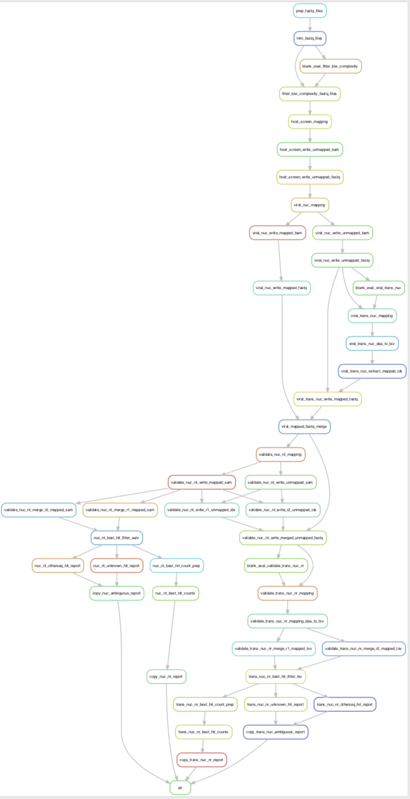
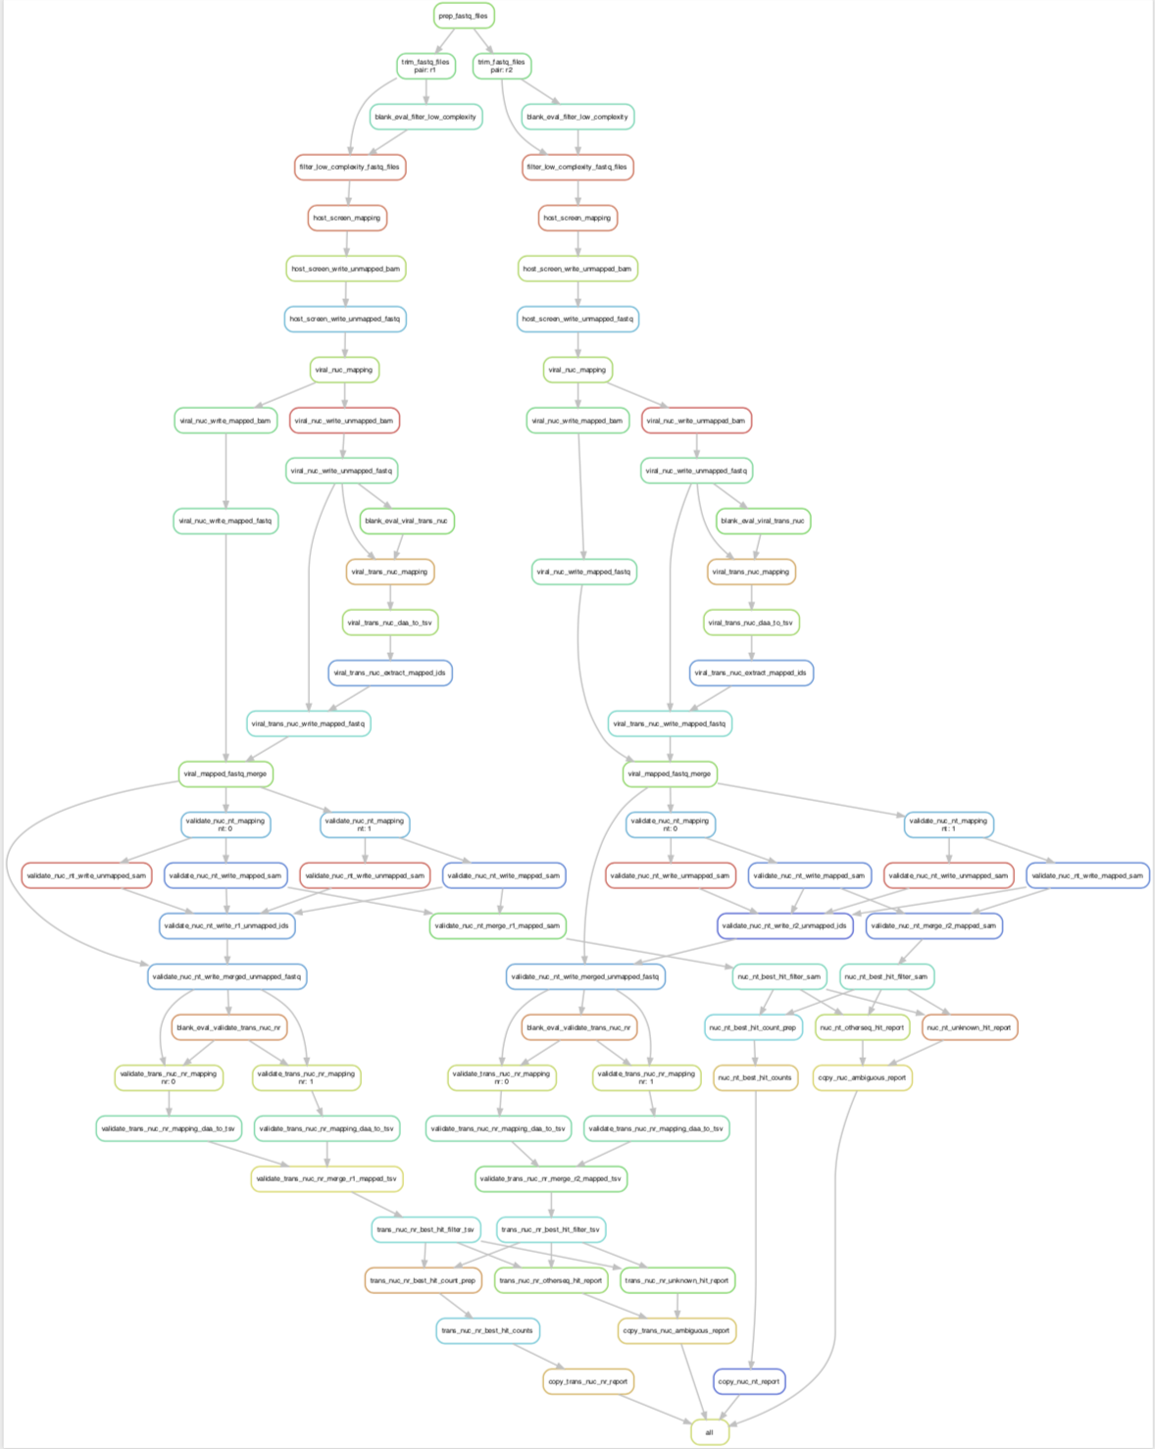
ViroMatch
Snakemake Rulegraph
Snakemake DAG
twylie@wustl.edu

Slide 43
Best Hit Logic
Determining a Read’s Best Hit
As outlined in NCBI nt Files and NCBI nr Files, the NCBI nt and nr reference databases are too large to index for alignment, so we split nt/nr into multiple indexed reference databases for independent alignment. Therefore, a candidate read will be aligned to all of the split nt or nr databases and a best hit will be determined during the best hit logic portion of the pipeline. While a read may have a good hit to one of the split reference databases, it may have a better or equally good hit to another split reference database.
Having multiple hits per read requires choosing a single best, representative hit for a read. Also, it is during this validation step that a read may have a better non-viral hit as compared to the initial viral-only database hit that flagged the read as a candidate for viral identity. All of the hits for a given read are evaluated at the same time in a read block. A read block is a list of alignment report lines, all having the same read id. In this way, we evaluate a smaller chunk of alignments at any one time. Although the alignment formats for nt and nr hits are different, the concept is the same. A read will be given the status of PASS or FAIL based on the underlying hits being evaluated. See Failure Codes for more details on read pass/fail evaluation.
https://twylie.github.io/viromatch/overview/best_hit_logic/
twylie@wustl.edu

Slide 44
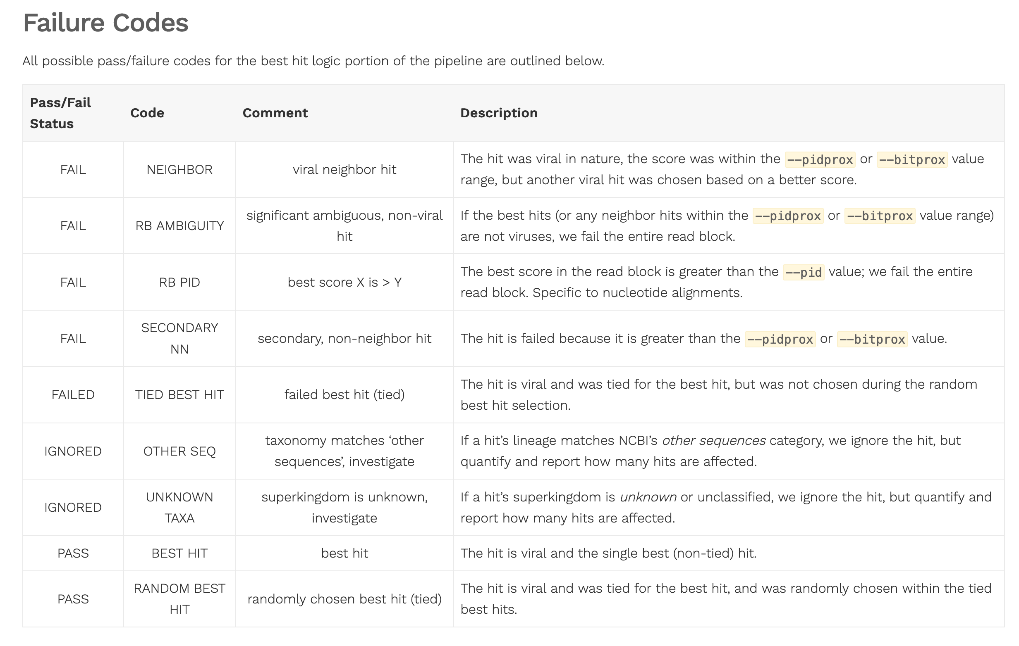
Failure Codes & Sanity Logs
https://twylie.github.io/viromatch/overview/reports/#sanity-files
twylie@wustl.edu

Slide 45
Taxonomy Reports
===========================================================================
NUCLEOTIDE ALIGNMENT READ COUNTS
===========================================================================
LINEAGE (R1 + R2)
--------------------
[1] read count
[2] percent
[3] lineage
--------------------
149 0.634 Viruses --> Caudovirales --> Podoviridae --> unclassified Podoviridae --> crAss-like viruses --> environmental samples --> uncultured crAssphage
36 0.153 Viruses --> Anelloviridae --> Gyrovirus --> Chicken anemia virus
12 0.051 Viruses --> Adenoviridae --> Mastadenovirus --> Human mastadenovirus D
5 0.021 Viruses --> Anelloviridae --> Gyrovirus --> unclassified Gyrovirus --> Avian gyrovirus 2
4 0.017 Viruses --> Anelloviridae --> Gyrovirus --> unclassified Gyrovirus --> Gyrovirus GyV3
4 0.017 Viruses --> Adenoviridae --> Mastadenovirus --> Human mastadenovirus D --> Human adenovirus D9
4 0.017 Viruses --> Adenoviridae --> Mastadenovirus --> Human mastadenovirus D --> Human adenovirus D10
3 0.013 Viruses --> Adenoviridae --> Mastadenovirus --> Human mastadenovirus D --> Human adenovirus 45
3 0.013 Viruses --> Anelloviridae --> Gyrovirus --> unclassified Gyrovirus --> Gyrovirus Tu789
3 0.013 Viruses --> Adenoviridae --> Mastadenovirus --> Human mastadenovirus D --> Human adenovirus 60a
2 0.009 Viruses --> Adenoviridae --> Mastadenovirus --> Human mastadenovirus D --> Human adenovirus 17
2 0.009 Viruses --> Adenoviridae --> Mastadenovirus --> Human mastadenovirus D --> Human adenovirus 25
2 0.009 Viruses --> Adenoviridae --> Mastadenovirus --> Human mastadenovirus D --> Human adenovirus 58
2 0.009 Viruses --> Adenoviridae --> Mastadenovirus --> Human mastadenovirus D --> Human adenovirus 38
1 0.004 Viruses --> Adenoviridae --> Mastadenovirus --> Human mastadenovirus D --> Human adenovirus 26
1 0.004 Viruses --> Adenoviridae --> Mastadenovirus --> Human mastadenovirus D --> Human adenovirus 20
1 0.004 Viruses --> Adenoviridae --> Mastadenovirus --> Human mastadenovirus D --> Human adenovirus 19
1 0.004 Viruses --> Adenoviridae --> Mastadenovirus --> Human mastadenovirus D --> Human adenovirus D13
--------------------
235 TOTAL
GENUS (R1 + R2)
--------------------
[1] read count
[2] percent
[3] genus
--------------------
149 0.634 unknown genus | uncultured crAssphage
48 0.204 Gyrovirus
38 0.162 Mastadenovirus
--------------------
235 TOTAL
SPECIES (R1 + R2)
--------------------
[1] read count
[2] percent
[3] species
--------------------
149 0.634 uncultured crAssphage
38 0.162 Human mastadenovirus D
36 0.153 Chicken anemia virus
5 0.021 Avian gyrovirus 2
4 0.017 Gyrovirus GyV3
3 0.013 Gyrovirus Tu789
--------------------
235 TOTAL
twylie@wustl.edu

Slide 46

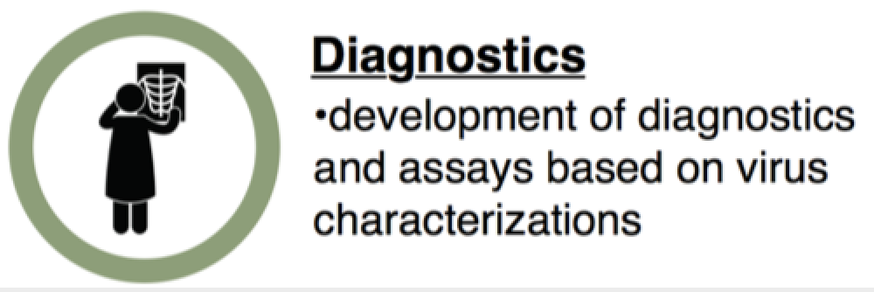
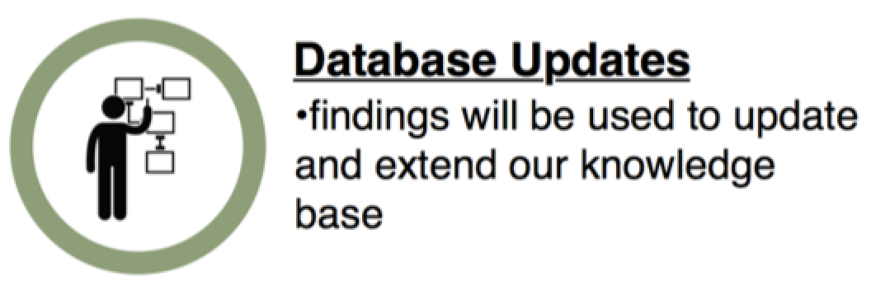
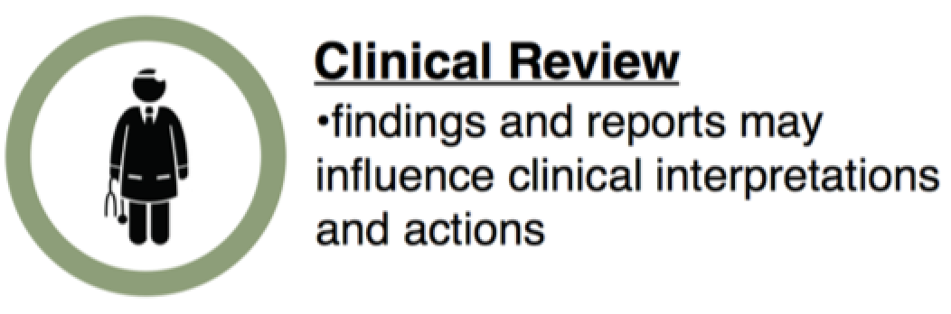

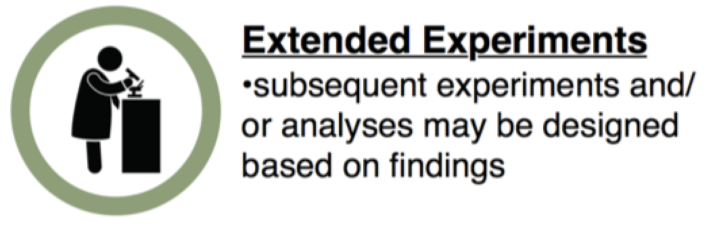
Report Evaluation
Virus reference assembly
Comparative genomics
Virus sub-typing
Biomarker and assay design
Databases & metadata
See:
Kristine Wylie, PhD (Jan. 11, 2021)
BFX Talk – Viruses
Image: PLOS Biology
twylie@wustl.edu

Slide 47
ViroMatch Output (live demo)
cmd.sh
CONFIG.yaml
lsf_logs
LSF.master.err
LSF.master.out
lsf_submitter.py
REPORT.nuc_ambiguous_counts.txt
REPORT.nuc_counts.txt
REPORT.trans_nuc_ambiguous_counts.txt
REPORT.trans_nuc_counts.txt
Snakefile
stats.log
steps.txt
viromatch_results -> /storage1/fs1/kwylie/Active/2020_09_21_AHA/redoPP2/mirror/
Example directory: /scratch1/fs1/kwylie/testPP2/
twylie@wustl.edu
Notes:
As long as project is active, we need disk space
Cumulative cohort data for aggregate analysis
Re-analysis
Data scrubbing and preparatory work (de-noising or data cuts)
Need to account for these things in grants

Slide 48
Acknowledgments
Krsitine Wylie Lab Kristine Wylie
Jane Schrimpf
Madison Eschbach
McKenzie Anderson
Claire Wild
Stephanie Lushniak
Renee Rubiano
Dylan Stoutenburg
Former Wylie Lab Members
Brandi Herter
Haley Gula
Galileu Barbosa Costa
WashU Phil Tarr
Vikas Dharnidharka
RIS
Matt Callaway
twylie@wustl.edu
Notes:
As long as project is active, we need disk space
Cumulative cohort data for aggregate analysis
Re-analysis
Data scrubbing and preparatory work (de-noising or data cuts)
Need to account for these things in grants

